Slide 1
PHP Framework: Laravel
Course Code: CSC 4182
Course Title: Advanced Programming In Web Technologies
Dept. of Computer Science
Faculty of Science and Technology
Lecture No: | 3 | Week No: | 02 | Semester: | Summer 2021-2022
Lecturer: | RASHIDUL HASAN NABIL; rashidul@aiub.edu

Slide 2
Lecture Outline
Introduction to Laravel
Starting the framework
Laravel directory structure
Routing basics
Routing Options
View Engine (Blade)
Creating Views

Slide 3
Introduction to Laravel
Why Laravel?
Laravel is a web application framework with expressive, elegant syntax.
Laravel makes easy the tasks of authentication, session, caching in web projects.
Powerful web applications can be made with Laravel.
Laravel framework makes implementation of authentication techniques very simple. Laravel provides a very simple way to organize authorization logic and control access to various resources.
Laravel is the best PHP framework as it has Object Oriented libraries and other pre-installed ones, which are not found in any other PHP frameworks.
Laravel framework offers a build in a tool named Artisan. This tool allows a developer to perform the majority of those repetitive and tedious programming tasks which most of the developers avoid performing manually.

Slide 4
Why Laravel?
Another reason which makes Laravel the best PHP framework is it supports MVC Architecture like Symfony, ensuring clarity between logic and presentation.
Laravel takes care of the security within its framework. It uses the hashed password, which means that the password would never save as the plain text in the database. Laravel framework uses prepared SQL statements which make injection attacks unimaginable.
With Laravel framework database migrations, it is extremely easy. As long as you keep all of the database work in migrations and seeds, you can easily migrate the changes into any other development machine you have.
The Blade templating engine of the Laravel framework is very intuitive and helps to work with the typical PHP/HTML spaghetti so perfect, that’s it one of the best features of the Laravel framework.

Slide 5
Installation Process
We will be using windows operating system.
Laravel utilizes Composer to manage its dependencies.
At first install XAMPP which supports apace and mysql(MariaDB)
Download composer from https://getcomposer.org/download/
Git bash can be used.
Install composer.
Choose your text editor.(Notepad++,VSCode,Sublime etc.)

Slide 6
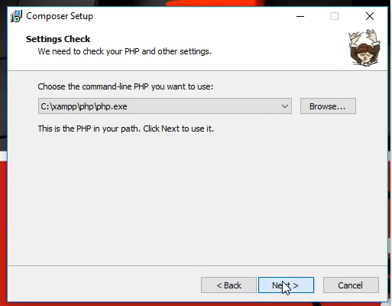
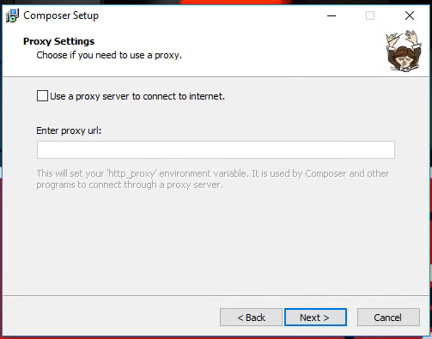
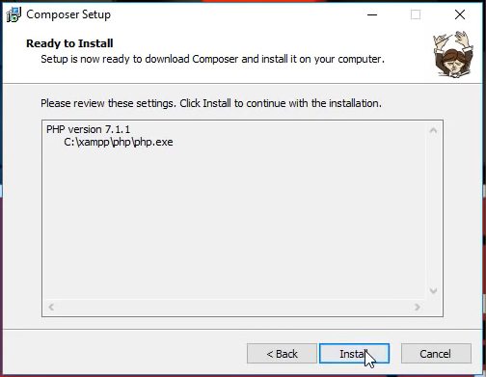
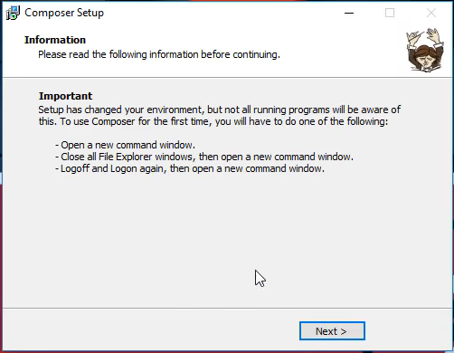
Installation Process

Slide 7
What is composer?
Compose is a tool which is used for dependency management for the framework
It allows you to declare the libraries your project depends on and it will manage (install/update) them for you.
It manages libraries on a per-project basis, installing them in a directory (e.g. vendor) inside your project.
You can update all your dependencies in one command with composer
Composer requires PHP 5.3.2+ to run.
Composer is multi-platform and we strive to make it run equally well on Windows, Linux and macOS.
With composer its very easy to create and manage projects and update dependencies.

Slide 8
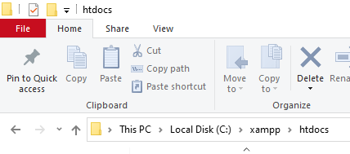
Starting the Framework
Creating the project
PHP codes are to be placed in htdocs folder.
If you have git bash installed you can use it for running commands.
You can also use cmd application of windows.
Open cmd in htdocs folder.
Click here
Type cmd
Hit enter

Slide 9
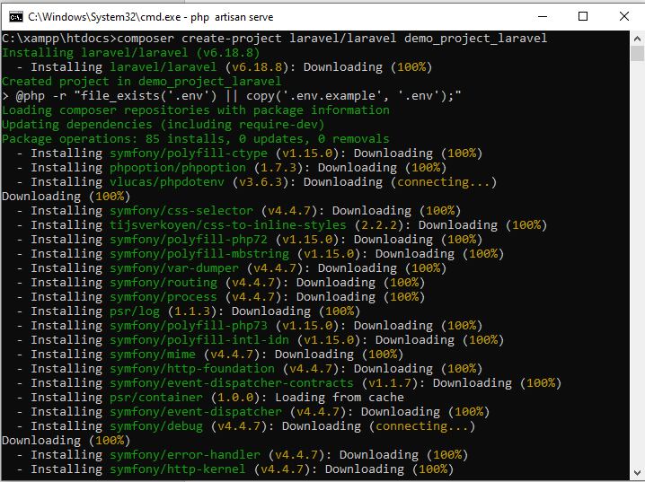
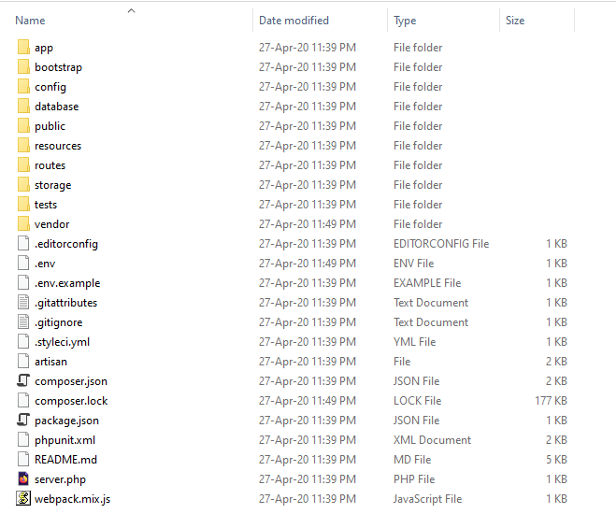
Creating the project
With composer we will be creating the project.
Write the below command to create a project.
composer create-project laravel/laravel your_project_name
Composer will download the required dependencies and create the project.
You will have your project created with required dependencies.

Slide 10
Running the project
The Laravel project can be run by 2 ways
With apache (Like other php apps we studied)
With built in development server
With apache
Open Xampp
Start apache
Open browser and type http://localhost/demo_project_laravel/
You will get the application directory
Click on public folder the default project interface will appear
You can also directly browse http://localhost/demo_project_laravel/public/
If you have running apache in any customized port like 8082 then don’t forget to mention the port like http://localhost:8082/demo_project_laravel/public/

Slide 11
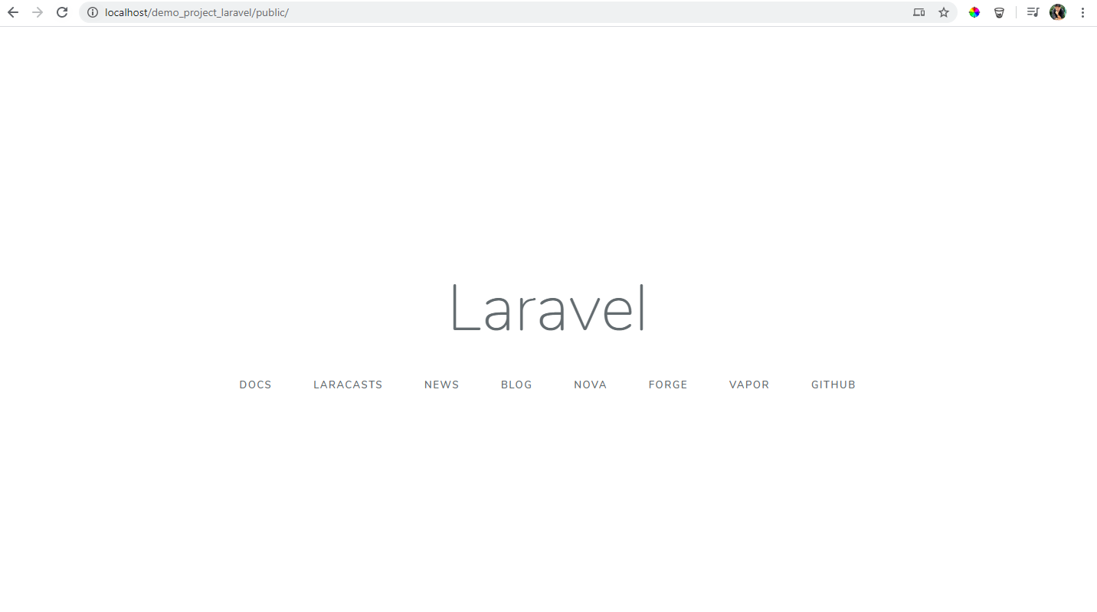
Running the project with apache

Slide 12
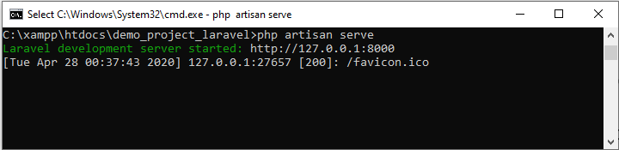
Running the project with built in development server
In Laravel, we can run Laravel Development server by typing php artisan serve command on terminal or command line.
Open cmd in project directory and type
php artisan serve
By default it will run in 8000 port. If 8000 is used then use another port.
php artisan serve --port=8082
The server will run now type
localhost:8000 [for default]
localhost:8082 [for customized port]
This is the URL of your project.
To stop the server type ctrl+c in the cmd.
It will directly take you to public folder.

Slide 13
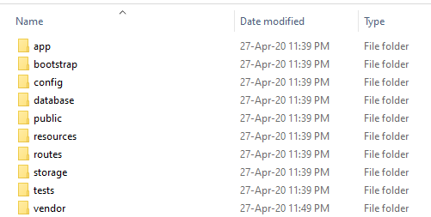
Application Directory Structure

Slide 14
Directory Structure
app - The app directory contains the core code of your application. We'll explore this directory in more detail soon; however, almost all of the classes in your application will be in this directory.
bootstrap - The bootstrap directory contains the app.php file which bootstraps the framework. This directory also houses a cache directory which contains framework generated files for performance optimization such as the route and services cache files.
config - The config directory, as the name implies, contains all of your application's configuration files. It's a great idea to read through all of these files and familiarize yourself with all of the options available to you.
database - The database directory contains your database migrations, model factories, and seeds. If you wish, you may also use this directory to hold an SQLite database.
public - The public directory contains the index.php file, which is the entry point for all requests entering your application and configures autoloading. This directory also houses your assets such as images, JavaScript, and CSS.
resources - The resources directory contains your views as well as your raw, un-compiled assets such as LESS, SASS, or JavaScript. This directory also houses all of your language files.

Slide 15
Directory Structure
routes - The routes directory contains all of the route definitions for your application. By default, several route files are included with Laravel: web.php, api.php, console.php and channels.php.
storage - The storage directory contains your compiled Blade templates, file based sessions, file caches, and other files generated by the framework.
app - The app directory may be used to store any files generated by your application.
framework - The framework directory is used to store framework generated files and caches.
logs - the logs directory contains your application's log files.
Generally storage/app/public is used to store files. In that case you should
create a link with public/storage by php artisan storage:link command.
test - The tests directory contains your automated tests.
vendor - The vendor directory contains your Composer dependencies.

Slide 16
app Directory Structure
Console - The Console directory contains all of the custom Artisan commands for your application. These commands may be generated using the make:command command. This directory also houses your console kernel, which is where your custom Artisan commands are registered and your scheduled tasks are defined.
Exceptions - The Exceptions directory contains your application's exception handler and is also a good place to place any exceptions thrown by your application. If you would like to customize how your exceptions are logged or rendered, you should modify the Handler class in this directory.
Http - The Http directory contains your controllers, middleware, and form requests. Almost all of the logic to handle requests entering your application will be placed in this directory.
Providers - The Providers directory contains all of the service providers for your application. Service providers bootstrap your application by binding services in the service container, registering events, or performing any other tasks to prepare your application for incoming requests.
Mail - This directory does not exist by default, but will be created for you if you execute the make:mail Artisan command. The Mail directory contains all of your classes that represent emails sent by your application. Mail objects allow you to encapsulate all of the logic of building an email in a single, simple class that may be sent using the Mail::send method.

Slide 17
Laravel Routing
Routing is one of the essential concepts in Laravel.
Routing in Laravel allows you to route all your application requests to its appropriate controller.
The most basic Laravel routes accept a URI and a Closure, providing a very simple and expressive method of defining routes.
Route::method(uri,closure);
Route::get('/hello', function () {
return 'Hello World';
});
All Laravel routes are defined in your route files, which are located in the routes directory.
These files are automatically loaded by the framework. The routes/web.php file defines routes that are for your web interface.
URI
Closure

Slide 18
Routing
These routes are assigned the web middleware group, which provides
features like session state and CSRF protection.
For most applications, you will begin by defining routes in your routes/web.php file.
The routes defined in routes/web.php may be accessed by entering the defined route's URL in your browser.
http://localhost:8000/hello
We can also write necessary functions in other files and bind them with route.
Available routing methods
Route::get($uri, $callback);
Route::post($uri, $callback);
Route::put($uri, $callback);
Route::patch($uri, $callback);
Route::delete($uri, $callback);
Route::options($uri, $callback);
If you are defining a route that redirects to another URI, you may use the Route::redirect method.
Route::redirect('/here', '/there');

Slide 19
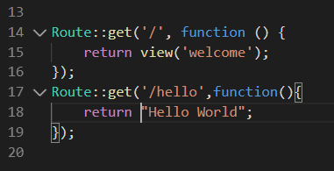

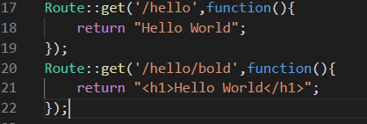

Creating First Route
Open routes/web.php in any text editor. Here VsCode will be used.
Write a route
Route::get('/hello', function () {
return 'Hello World';
});
Type the route in browser
http://localhost:8000/hello
Try this
Route::get('/hello/bold', function () {
return '<h1>Hello World</h1>';
});
Output
You can add as much routes you can and also add HTML with it.

Slide 20
Routing Options
In the second parameter of the route, we have the following options:
A Closure
An Array
A String
Example:
Closure: Route::get('/home', function(){return "Hello"});
Array: Route::get('/home', ['uses'=>'HomeController@index']);
String: Route::get('/home', 'HomeController@index'});

Slide 21
View Engine (Blade)
Till now we can create routes and give output in HTML we can add HTML tags and design also but its not convenient to write HTML codes here.
Views typically contain the HTML of your application and provide a convenient way of separating your controller and domain logic from your presentation logic.
<html>
<body>
<h1>Hello, Form View</h1>
</body>
</html>
For views we will be using blade engine. Blade is the simple, yet powerful templating engine provided with Laravel.
Unlike other popular PHP templating engines, Blade does not restrict you from using plain PHP code in your views.
Blade views are compiled into plain PHP code and cached until they are modified, meaning Blade adds essentially zero overhead to your application.

Slide 22
View Engine (Blade)
Blade view files use the .blade.php file extension.
Files with blade are stored in the resources/views directory.
Using blade as Layout will be discussed later studies. Lets create our first view.

Slide 23
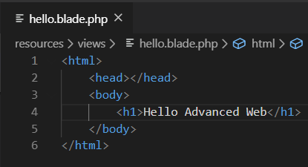
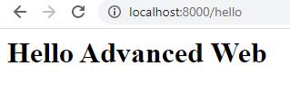

Creating Views
Go to resources/views
Create a file with .blade.php
Put some html codes
After creating views we need to bind it with
Route
Go to web.php and define a route or
Modify existing one
Route::get('/hello',function(){
return view("hello");
})->name('hello');
view() function receives the blade file name.
Give only the file name without .blade.php

Slide 24
Books
PHP Advanced and Object-Oriented Programming, 3rd Edition; Larry Ullman; Peachpit, Press, 2013
PHP Objects, Patterns and Practice, 5th Edition; Matt Zandstra; Apress, 2016
Learning PHP, MySQL, JavaScript and CSS, 2nd Edition; Robin Nixon; O’Reilly, 2009
Eloquent JavaScript: A Modern Introduction to Programming; Marijn Haverbeke; 2011
Learning Node.js: A Hands On Guide to Building Web Applications in JavaScript; Marc Wandschneider; Addison-Wesley, 2013
Beginning Node.js; Basarat Ali Syed; Apress, 2014

Slide 25
References
https://laravel.com/
https://getcomposer.org/
http://www.laravelinterviewquestions.com/

Slide 26
Thank You!

